Slide 1
CHAPTER-5
Control Unit Design

Slide 2
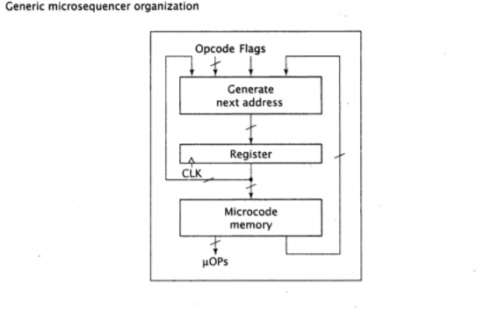
Basic micro-sequence design and operation

Slide 3
Contd…
REGISTER stores a value that corresponds to 1-state in the CPU state diagram. It serves as the address i.e. input to the micro-code memory.
MICRO-CODE memory outputs a micro-instruction and the content of memory location for this address. =>MICRO-INSTRUCTION consists of several bit of fields which can be broadly classified into two groups. A. micro-operation that generates the control signal. B. generate next address to be stored in the register. These bits, along with the instruction opcode and flag values are input to the combinational logic that generates the address of next micro-instruction.
The ‘Generate Next Address’ block of micro-sequencer typically generate all possible next address and then select correct next address to pass to the register. =>One possible value of the next address is the current address + 1. =>Another possible address is an absolute address supplied by the micro-code. For example, at the end of every execute routine, the micro-sequencer must jump back to the beginning of fetch routine.

Slide 4

Microinstruction format
SELECT field: determines source of address of next microinstruction. It doesn’t specify the actual address, but only the source of the address.
ADDR field: specifies an absolute address. Used when performing absolute jump. => Microinstructions that specify another source for the next address, such as mapping address do not use bits of this field.
MICRO-OPERATIONS field: three primary methods. => horizontal microcode => vertical microcode => Direct generation of control signals

Slide 5
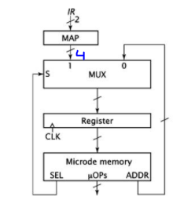
Design and implementation of a very simple microsequencer:
Consider the state diagram in the CPU design.
In this only two possible next addresses are used; the opcode mapping and an absolute jump.
Fetch3 goes to one of the four execute routines; implemented via the mapping input.
Remaining states must go to next specific address; implemented via absolute jump.

Slide 6
Contd…
MUX is used to select one of the two possible address.
Select bit generated by microsequencer is used to choose correct next address.
A total of 9 states in the state diagram, and hence 4-bits needed to represent them.

Slide 7
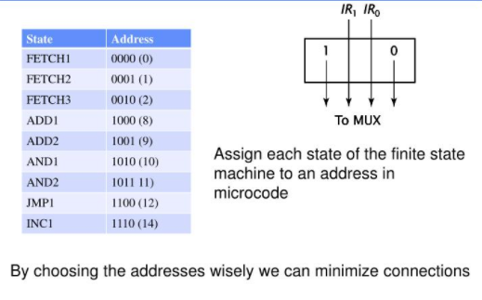
Control sequence generation and mapping logic
The microsequencer uses the mapping function namely 1IR[1..0]0 which provides the address of 1000,1010, 1100, 1110 for ADD1, AND1, JMP1 and INC1 respectively.

Slide 8
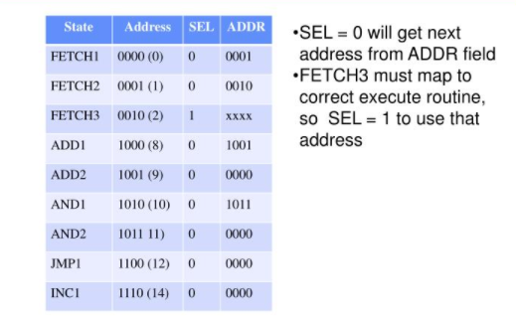
Contd…
For eg, to go from Fetch1 to Fetch2, the microsequencer will specify SEL=0 and ADDR = 0001

Slide 9
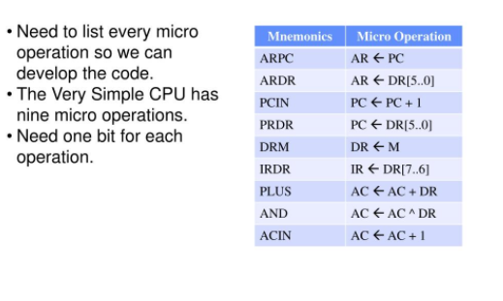
Generation of micro operation using horizontal microcode (micro operations and their mnemonics for the very simple microsequencer)

Slide 10
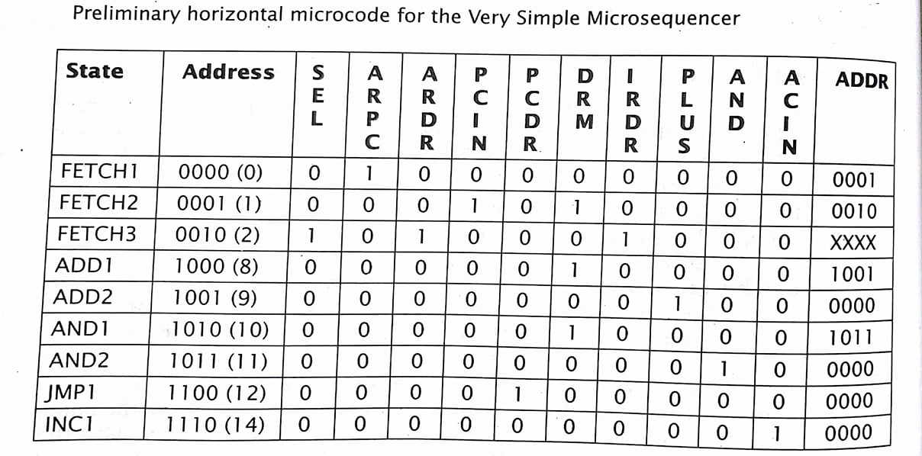
Contd… (Preliminary horizontal microcode for the very simple microsequencer)

Slide 11
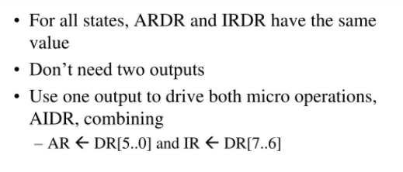
Contd.. (optimize)

Slide 12
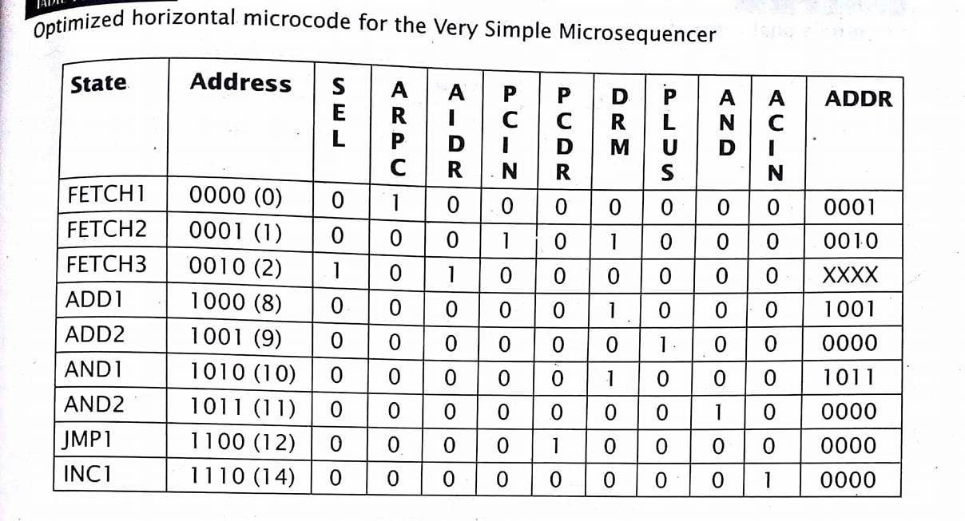
Contd… (optimized horizontal microcode for the very simple microsequencer)

Slide 13
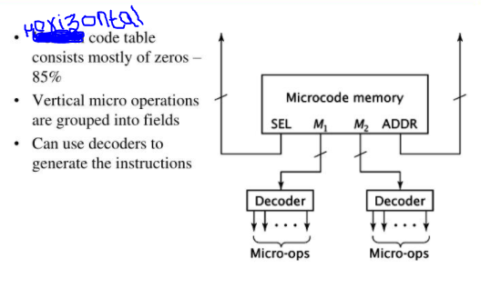
Generation of micro operation using vertical microcode (vertical microcode offers a way to reduce a number of bits)

Slide 14
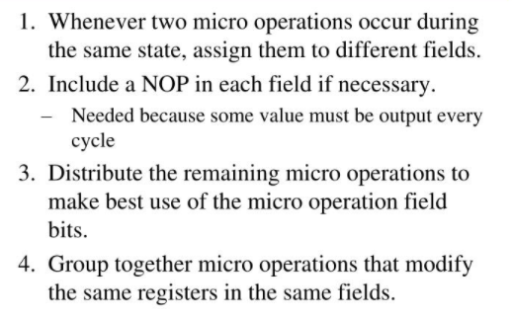
Contd.. (guidelines to design microsequencer using vertical microcode)

Slide 15
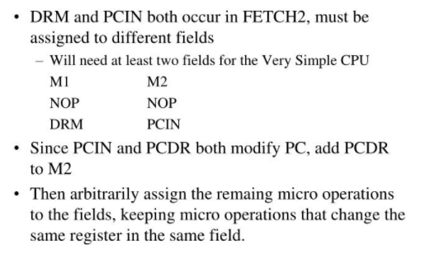
Contd…

Slide 16
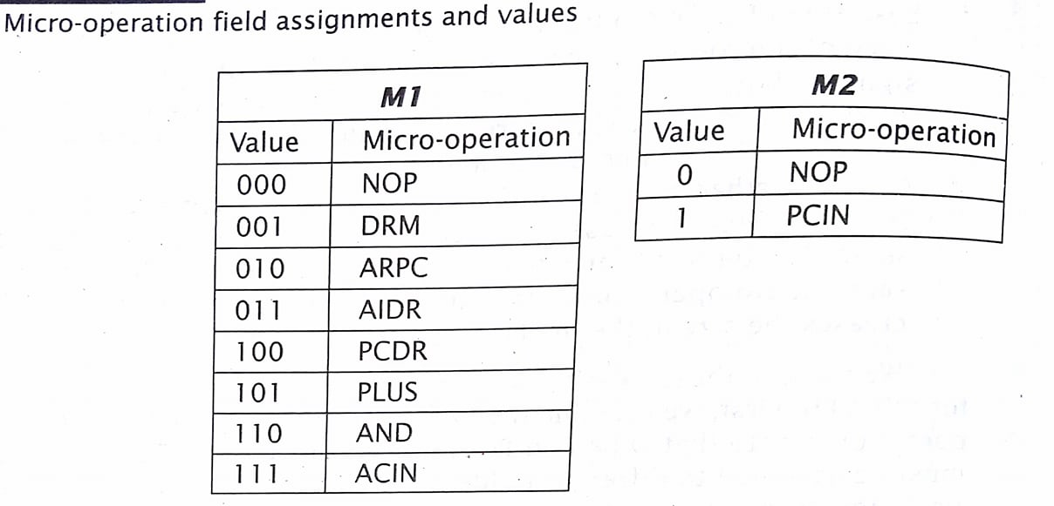
Contd…
To optimize, it is best to maximize to a power of two, so is possible, put eight micro operations in M1 and two in M2.
M1 requires 3 bits, M2 only one bit, for total of 4 bits.

Slide 17
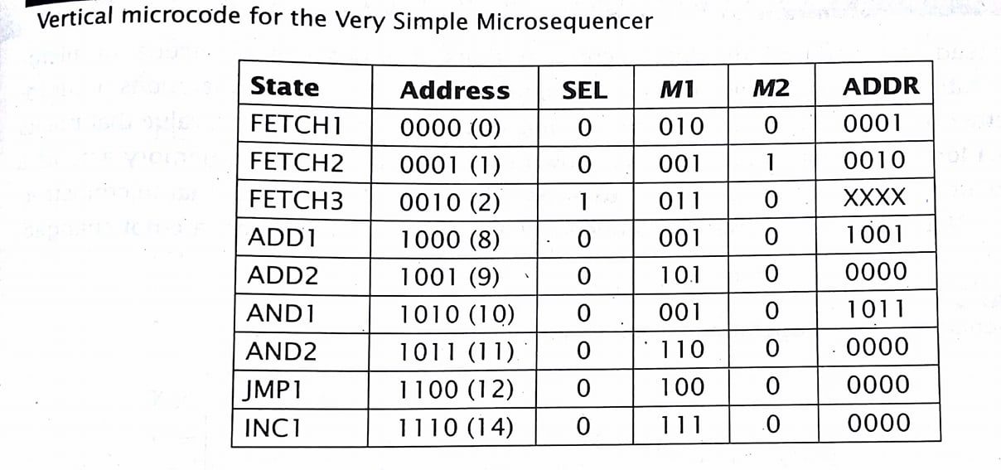
Contd… (vertical microcode for the very simple microsequencer)

Slide 18
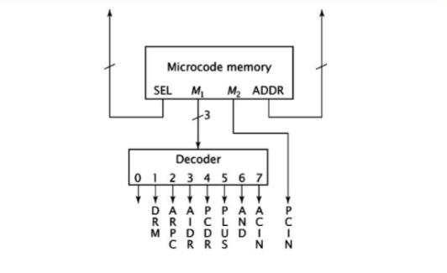
Contd.. (generating micro operations for vertical microcode for the very simple CPU)

Slide 19
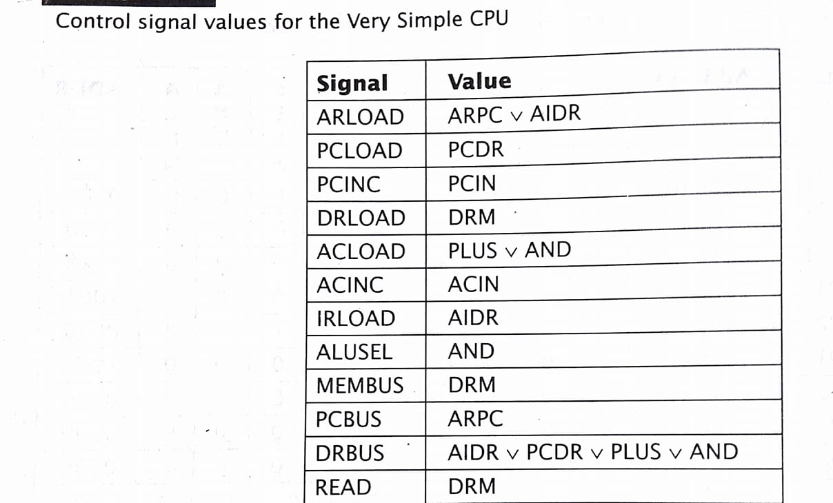
Control signal values for the very simple CPU

Slide 20
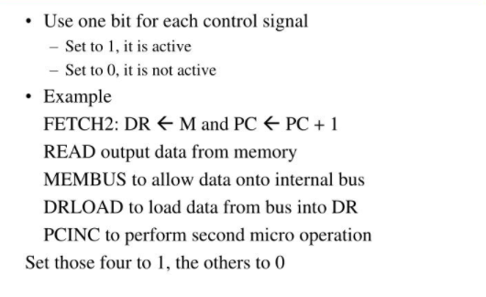
Directly generating control signals from the microcode (Instead of outputting micro operation from the microcode memory and generating control signals from these micro operations, we could output the control signals directly)

Slide 21
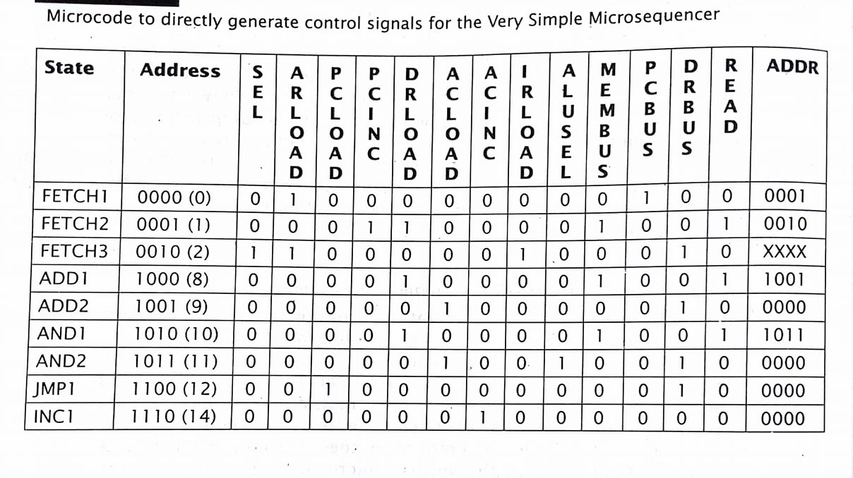
Contd…

Slide 22
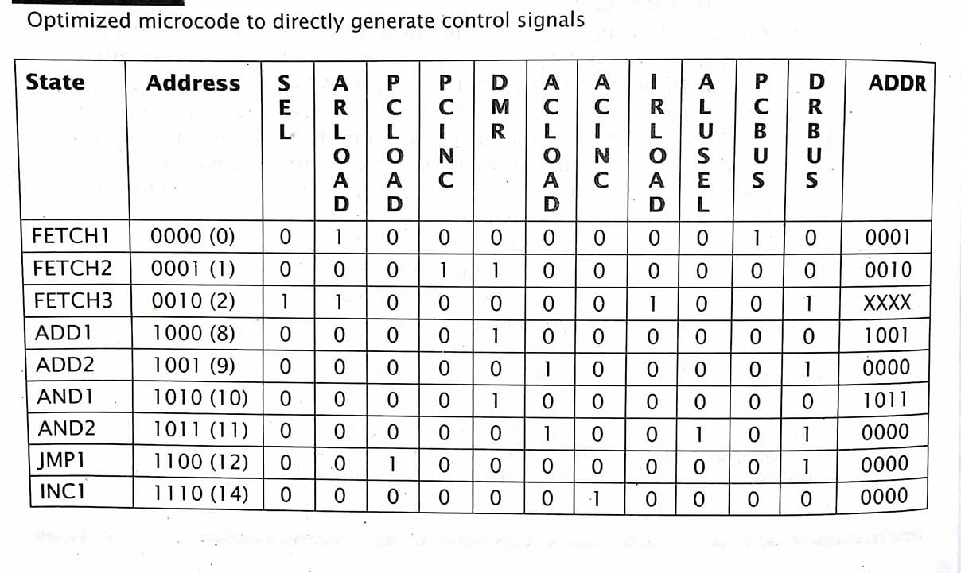
Contd…

Slide 23
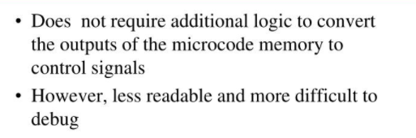
Advantage to directly generating control signals

Slide 24
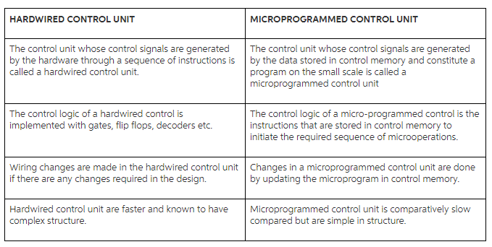
Microprogrammed Vs Hardwired control unit
As the number of instruction increases, the complexity of hardwire to generate control signals also increases. Therefore, for fewer number of instruction set, hardwire control unit is better, but for higher number of instruction set, microprogram may be suitable.

